Slide 1
Exception Handling
Entri
elevate

Slide 2
Exception Handling
An exception is an event, which occurs during the execution of a program that disrupts the normal flow of the program's instructions.
In general, when a Python script encounters a situation that it cannot cope with, it raises an exception. An exception is a Python object that represents an error.
When a Python script raises an exception, it must either handle the exception immediately otherwise it terminates and quits.
An unusual behavior of the software program
Divide by 0
Array Index out of bound

Slide 3
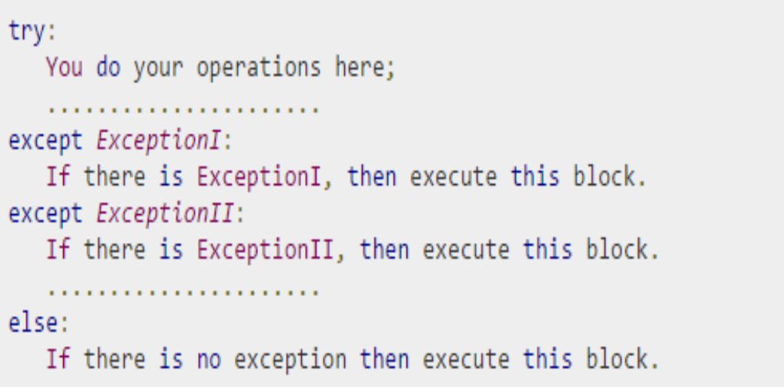
Syntax

Slide 4
Try-Catch-Finally
A single try statement can have multiple except statements. This is useful when the try block contains statements that may throw different types of
exceptions.
You can also provide a generic except clause, which handles any exception.
After the except clause(s), you can include an else clause. The code in the else-block executes if the code in the try: block does not raise an exception.
The else-block is a good place for code that does not need the try: block's protection.

Slide 5
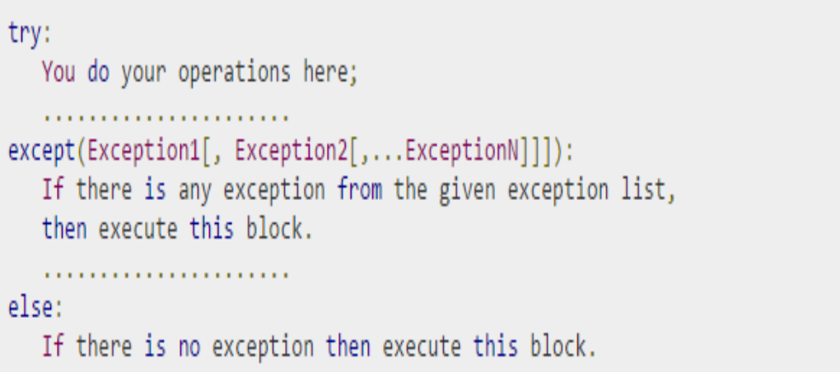
The Except clause with multiple Exceptions

Slide 6
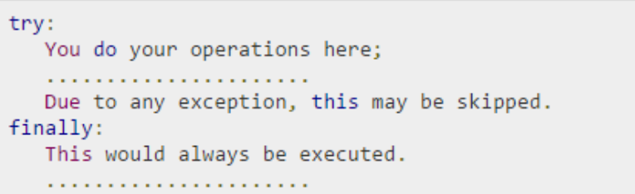
Try-Finally clause
You can use a finally: block along with a try: block.
The finally block is a place to put any code that must execute, whether the try-block raised an exception or not. The syntax of the try-finally statement is this −

Slide 7
Raising an Exception
You can raise exceptions in several ways by using the raise statement. The general syntax for the raise statement is as follows.
raise [Exception [, args [, traceback]]]
Here, Exception is the type of exception (for example, NameError) and argument is a value for the exception argument. The argument is optional; if not supplied, the exception argument is None.

Slide 8
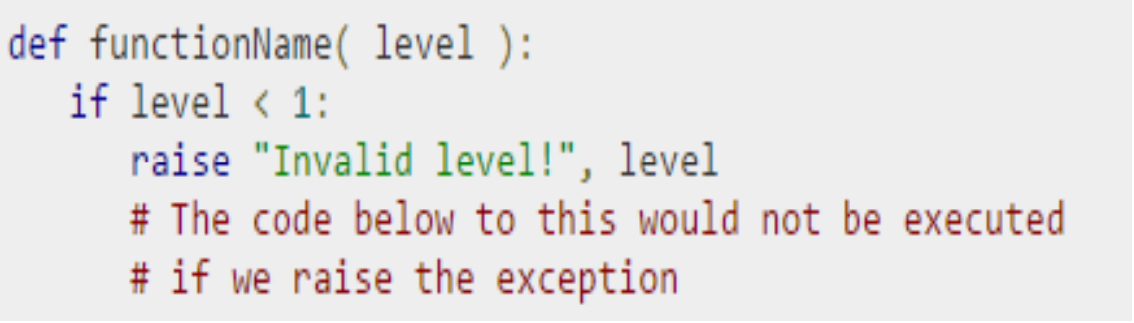
Example

Slide 9
THANK YOU
E

